Slide 1



Team 60B
Team Members: Yamin Alam & Veena Chebrolu
Mentor: Mr. Jerry Ojimadu
INTERNSHIP REPORT
DATA ANALYTICS ASSOCIATE

Slide 2
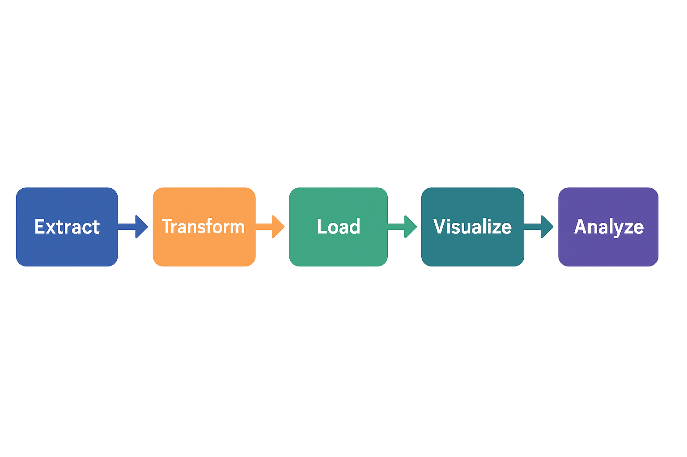

PROJECT OVERVIEW
6 primary datasets with 100K+ records
Extract data to PostgreSQL
Data cleaning & transformation
EDA and ETL report creation
Master table creation
Wireframe of dashboard
Interactive dashboard development

Slide 3
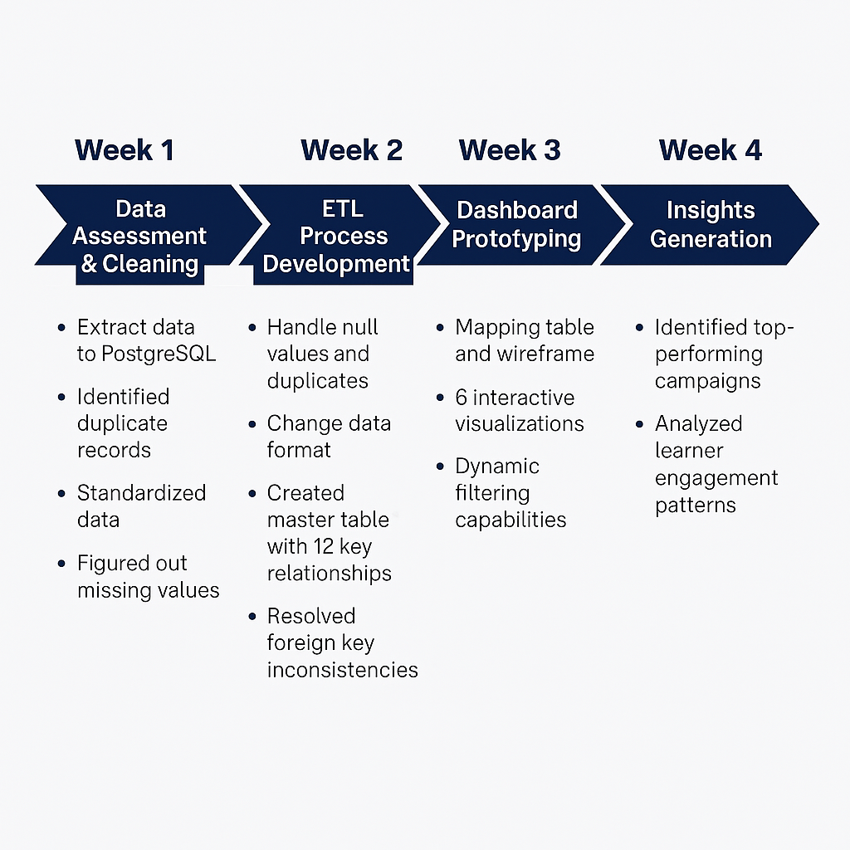

JOURNEY
DATA

Slide 4

DATA ARCHITECTURE
Core Tables
Key Relationships
learner_raw (76,482 records)
marketing_data (139 campaigns)
cognito_raw (86,302 users)
campaign_id → learner_id → opportunity_id → cohort_code
98.7% referential integrity achieved

Slide 5
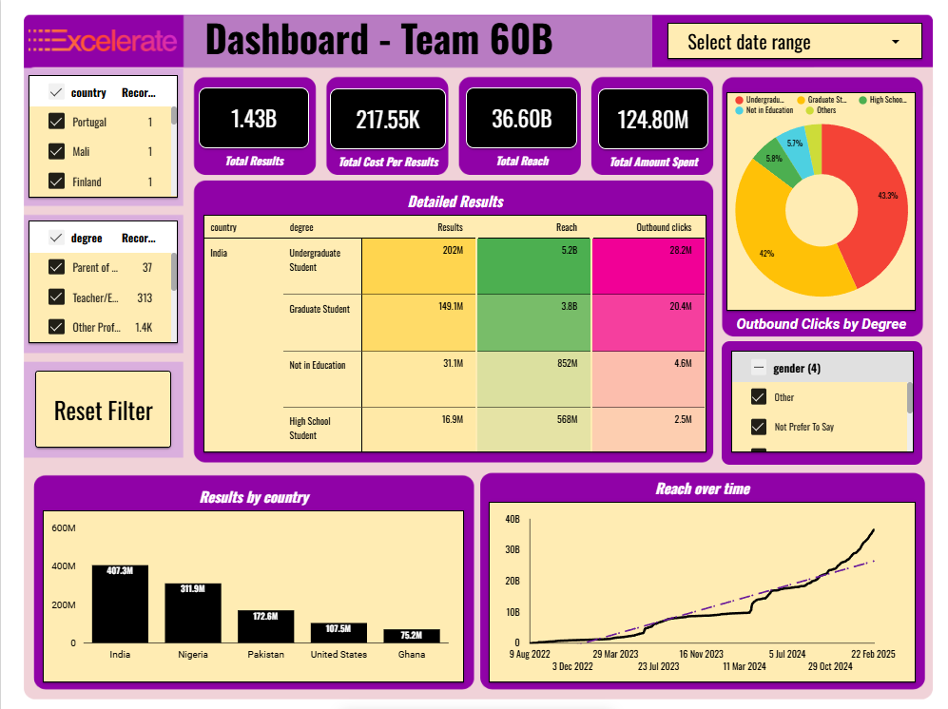


Dashboard of Team 60B

Slide 6
DASHBOARD

Slide 7
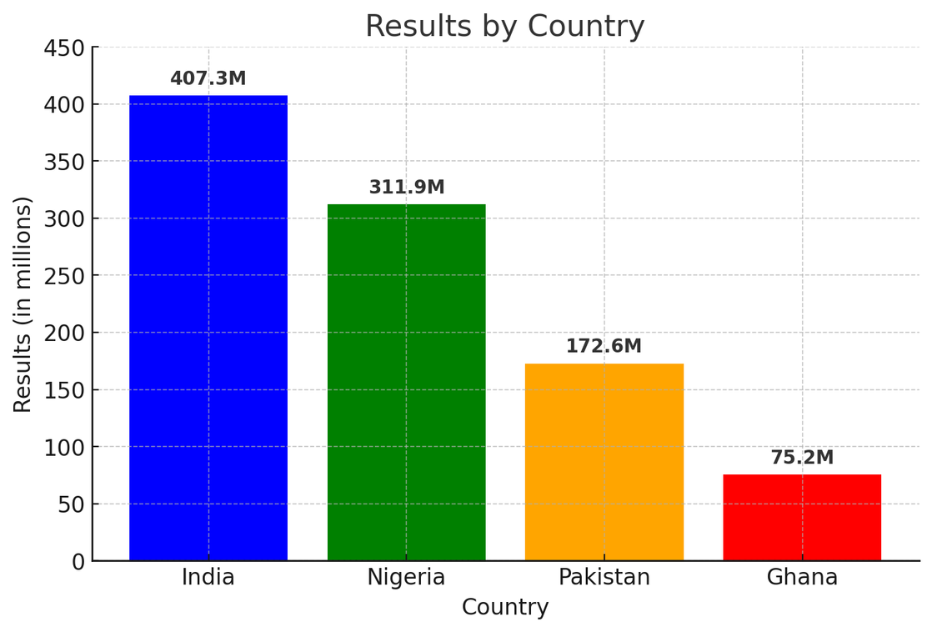




GEOGRAPHIC PERFORMANCE HIGHLIGHTS
India
407.3M results
Nigeria
311.9M results
Pakistan
172.6M results
Ghana shows 75.2M results with only 2.3% of total spend

Slide 8
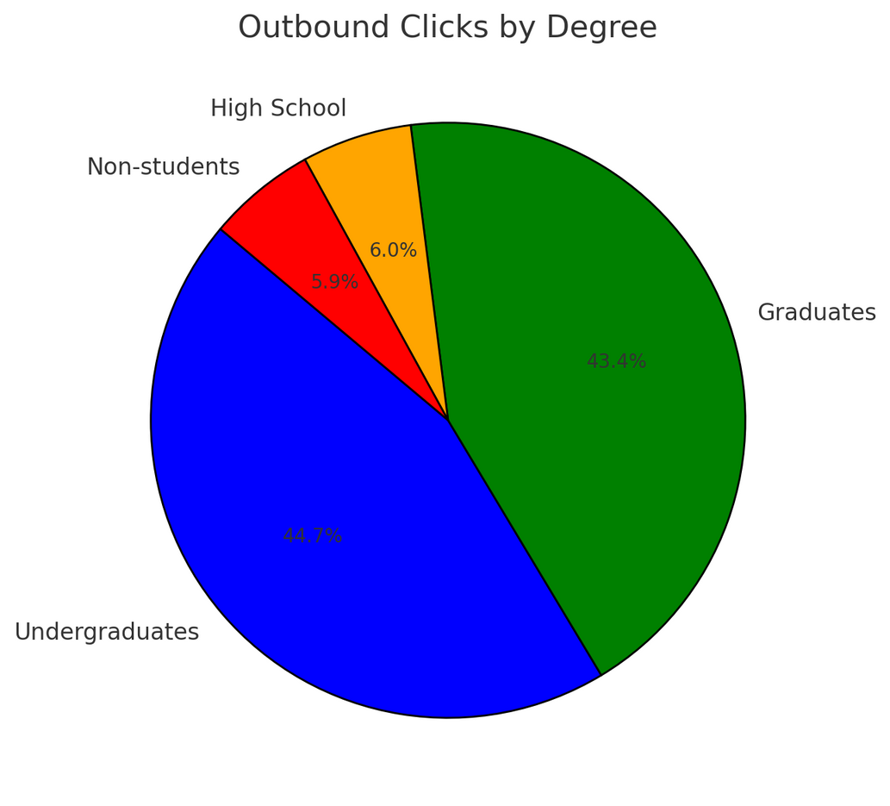
EDUCATION-LEVEL INSIGHTS
Top Performers:
Undergraduates: 44.7% of engagement
Graduates: 43.4% of engagement
Underrepresented:
High School: Only 6.0% of clicks
Non-students: 5.9% of clicks

Slide 9
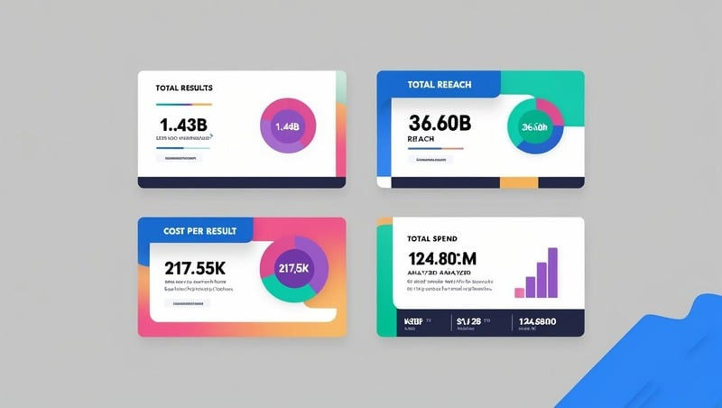
MARKETING EFFICIENCY METRICS

Slide 10
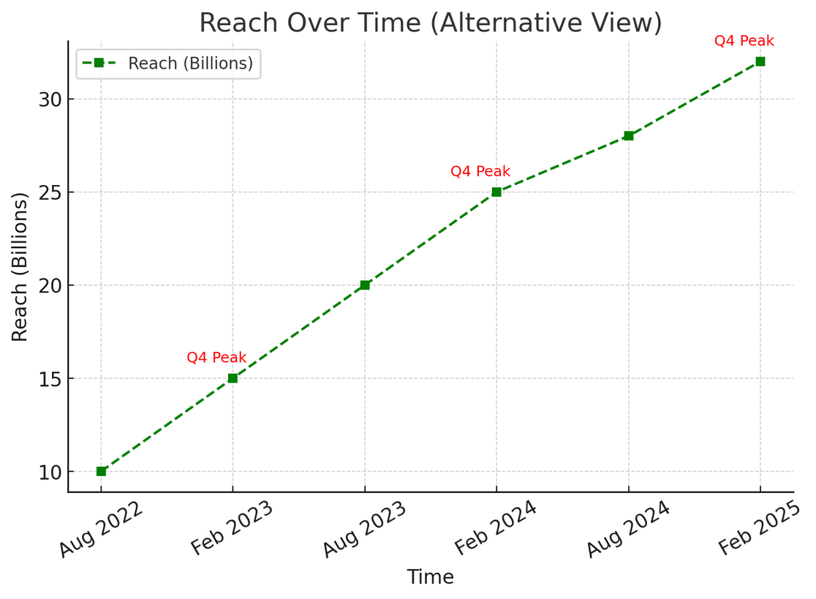
TEMPORAL TRENDS
Steady Growth: From 10B in Aug 2022 to 30B+ in Feb 2025
Accelerating Trajectory: Growth rate increasing over time
Seasonal Patterns: Visible peaks in Q4 each year

Slide 11


DATA QUALITY IMPROVEMENTS
12 columns standardized
47,807 duplicates removed
98.5% missing values resolved

Slide 12
1
2
Recommendations
Reallocate 10-15% of marketing budget to high-ROI campaigns
Develop graduate-focused content offerings
3
4
5
Pilot smaller cohort sizes for improved completion
Expand Ghana market presence
Apply Q4 strategies throughout the year

Slide 13
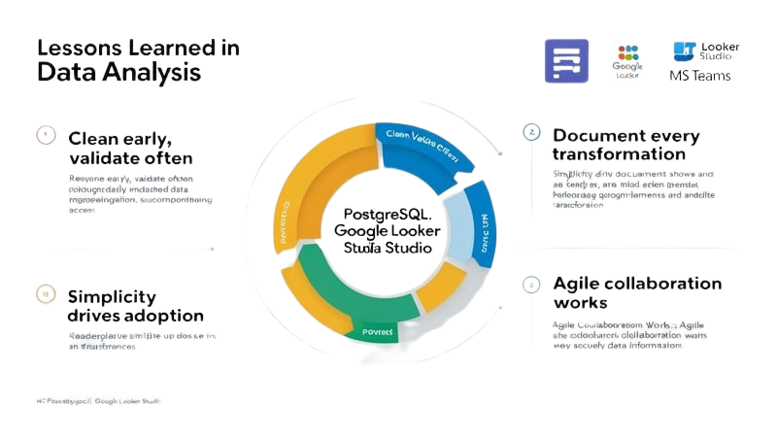



LESSON LEARNED IN INTERNSHIP
TOOLS

Slide 14
THANK YOU
FOR THE OPPORTUNITY

Slide 15


